Slide 1

CONSUMER
GOODS
AD-HOC
ANALYSIS
PERSONAL INITIATIVE PROJECT
CREATED BY : DIVYAJYOTI SAHOO
TECH STACK USED :
MySQL
Miro-ERD
Power BI

Slide 2
AGENDA
Business Overview
Markets
Product Line
Data Model
Ad-Hoc Queries
Conclusion

Slide 3
BUSINESS OVERVIEW
Domain: Consumer Goods
Business Overview:
AtliQ Hardware is a fictitious company that sells computer hardware and peripherals like PC, mouse, printer etc. to clients across the world.
They have a major B2B business model wherein they sell to stores like Croma, Best Buy, Staples, Flipkart etc. who then sell it to the end users (consumers). These stores are their main customers.
They sell through 3 channels: Retailer, Direct and Distributor.
AtliQ Hardware's Customers are of two types. Both these Platforms are called Retailer channels.
Brick & Mortar Customer: Actual physical stores e.g. Croma, Best Buy
E-commerce Customer: Online websites E.g. Amazon, Flipkart
AtliQ Hardware also has a minor B2C business model wherein they own stores: AtliQ E-store and AtliQ Exclusive. These are called Direct channels.
They manufacture products under 3 major divisions: Networking & Storage, PC, Peripherals & Accessories.
They are currently operational in NA, LATAM, EU and APAC regions

Slide 4
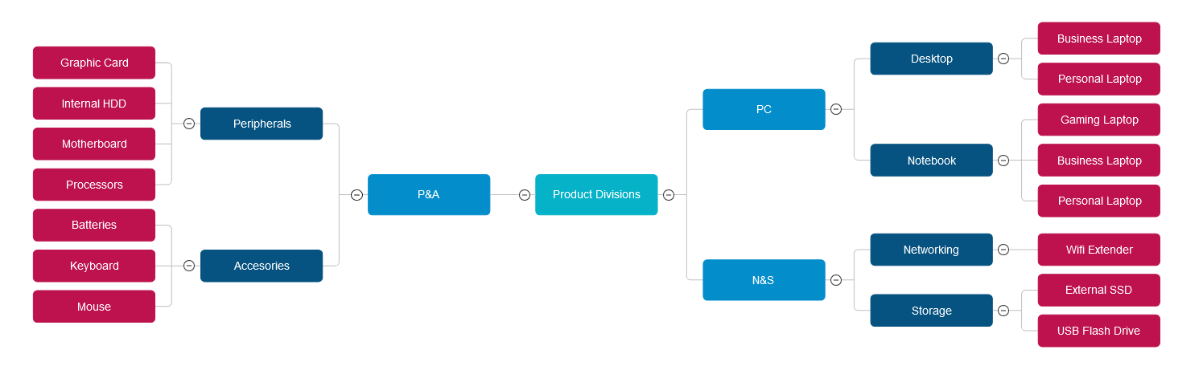
PRODUCT LINE

Slide 5
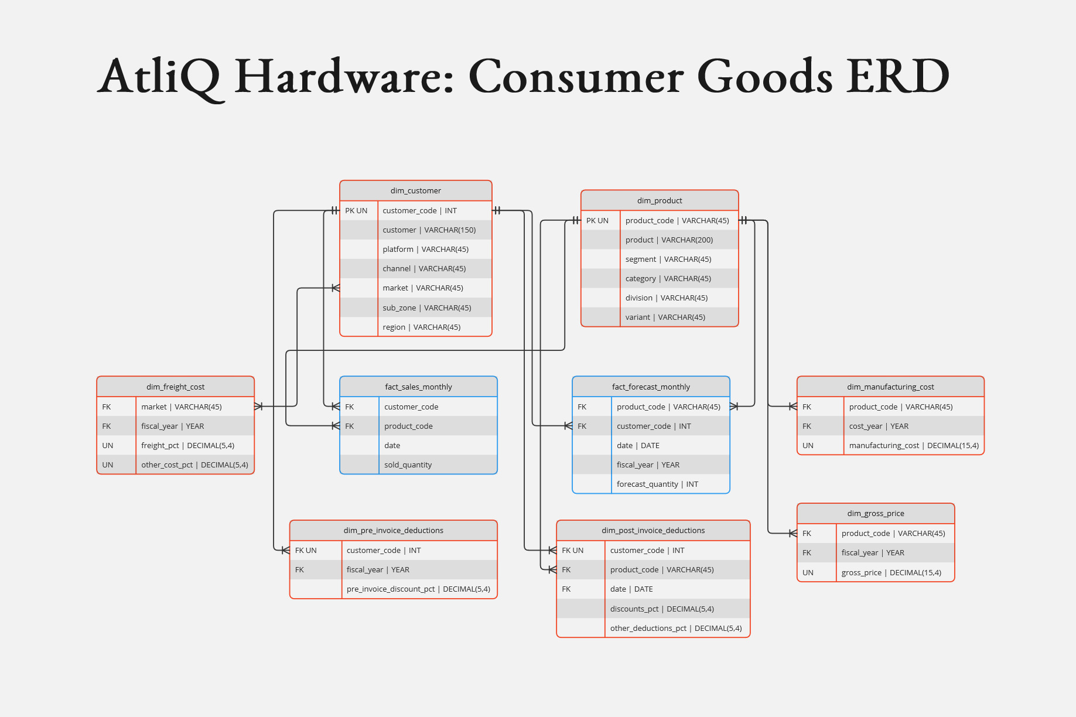
CONSUMER GOOD ERD
DATA MODEL

Slide 6

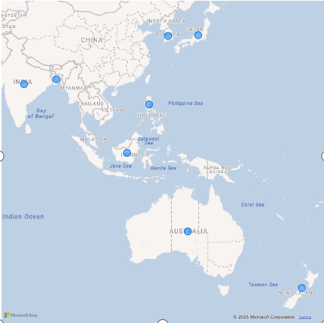
1. Provide the list of markets in which customer “Atliq Exclusive” operated its business in APAC region.
AtliQ Hardware operates across four major regions: North America (NA), Latin America (LATAM), Europe (EU), and Asia Pacific (APAC). This global presence allows AtliQ to serve diverse customer needs with products in Networking and Storage, PCs, Peripherals and Accessories.
Atliq Exclusive has established a presence in eight key markets within the APAC region listed as follows
India
Indonesia
Japan
Philippines
South Korea
Australia
New Zealand
Bangladesh

Slide 7
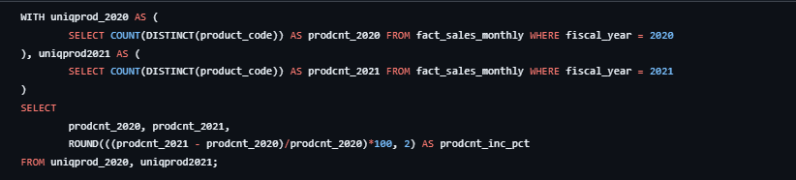
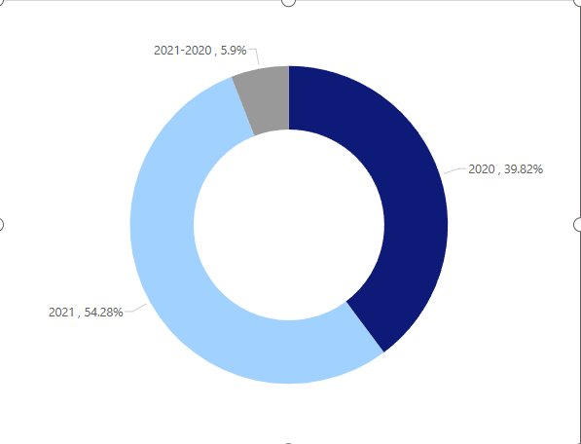
Unique products in 2020 , 2021 What is the percentage of unique product increase in 2021 vs. 2020?
In FY 2020, we had a total of 245 products and in FY 2021, the number of products increased to 334, reflecting a 36.33 % growth.

Slide 8
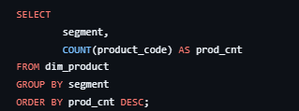
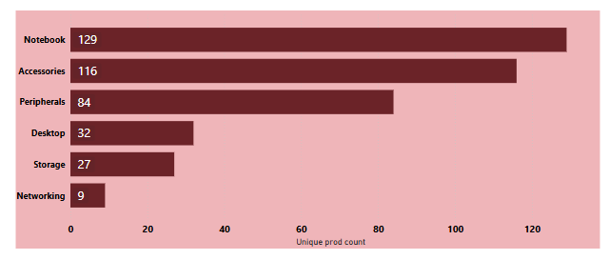
Provide a report with all the unique product counts for each segment and sort them in descending order of product counts.
Atliq Hardware presents an extensive array of products across the Notebook, Accessories and Peripherals segments.- There is a strategic need consider strategies to broaden the product portfolio by introducing trending products in lower-count segments like Desktop, Networking, and Storage segments

Slide 9
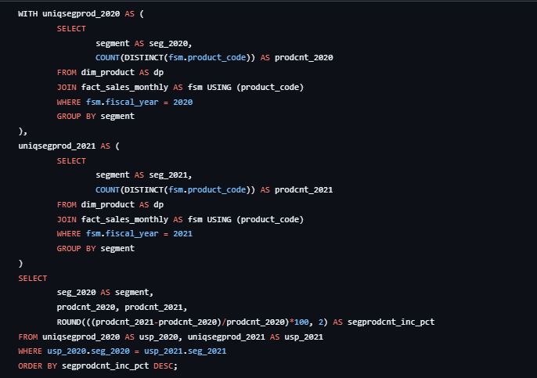
Which segment had the most percentage increase in unique products in 2021vs 2020?
In FY 2021, Atliq Hardware primarily focused on expanding its presence in the Desktop segment, introducing a total of 15 new products (214.9 % growth from FY 2020) to the market.
-While Notebook segment had the highest product count of 108 in FY 2021, it experienced the slowest growth of just 17.39 % from FY 2020.

Slide 10
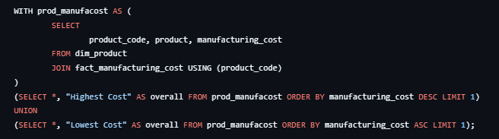
Get the products that have the highest and lowest manufacturing costs. The final output should contain these fields,
Review production processes for high-cost products in PC segment to identify potential cost-saving measures.
- Review production methods of low-cost products in P&A segment to replicate efficient practices across other product lines.

Slide 11
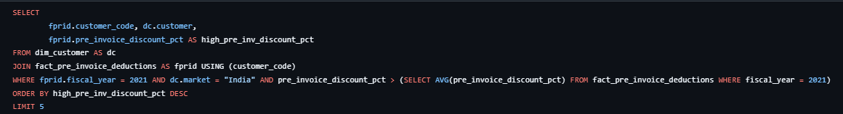
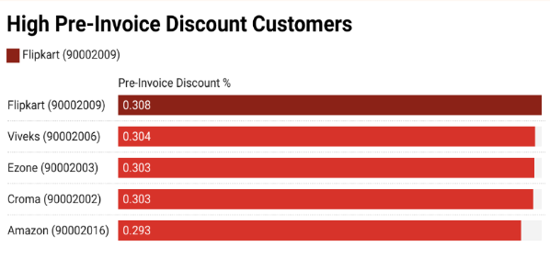
Generate a report which contains the top 5 customers who received a higher-than-average pre-invoice discount % for the fiscal year 2021 in the Indian market.
Flipkart (90002009) holds the position of the most heavily discounted customer in the Indian market, with a pre-invoice discount percentage of 30.83 % in FY 2021 as compared to the overall average of 23.4 %.- Atliq extended approximately similar pre-invoice discount percentages (~ 30 %) to each of its top 4 customers in FY 2021. AtliQ should engage in negotiations to secure more favorable terms with these high-discount customers by implementing loyalty programs or volume-based incentives to maintain customer satisfaction while reducing the average discount rate thereby improving profit margins

Slide 12
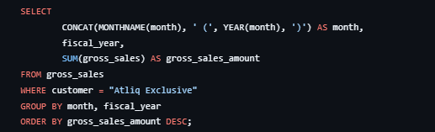
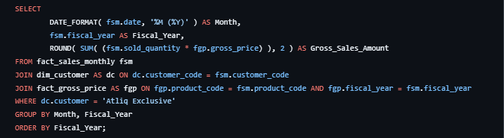
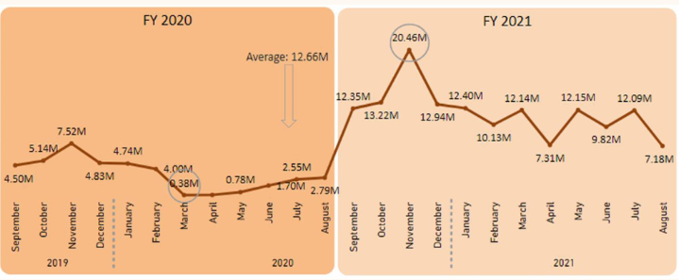
Get the complete report of the Gross sales amount for the customer “Atliq Exclusive” for each month . This analysis helps to get an idea of low and high-performing months and take strategic decisions.
Atliq Exclusive experienced its highest sales of 20.46M $ in November 2020, whereas March 2020 recorded the lowest sales of 0.38M $.
Monthly Gross Sales for Atliq Exclusive peaked in November and tanked in April for both 2019 and 2020.
Decline in Monthly Gross Sales between March and August 2020 can be attributed to the impact of Covid-19. Post Covid-19 sales have optimistically rebounded in August remaining robust and surpassing the levels seen in FY 2020

Slide 13
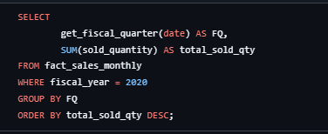
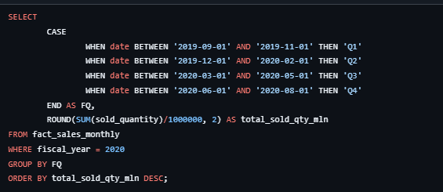
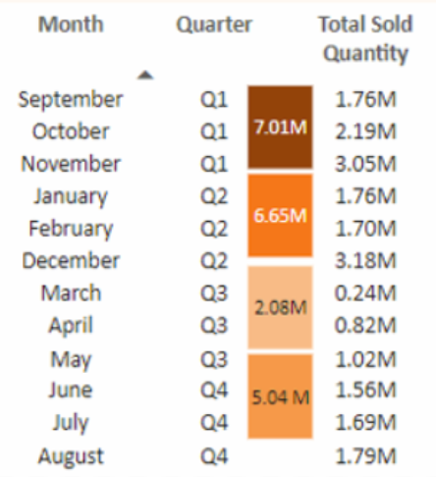
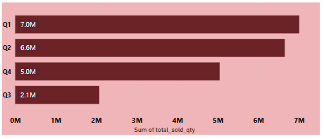
In which quarter of 2020, got the maximum total sold quantity? The final output is sorted by the total sold quantity.
In FY 2020 Q1 had the highest Total Sold Quantity at around 7.01 Million units.
In FY 2020 Q3 (March, April and May), the Total Sold Quantity plummeted to its lowest at around 2.08 Million units during the peak of Covid-19 due to widespread lockdowns impacting all businesses.

Slide 14
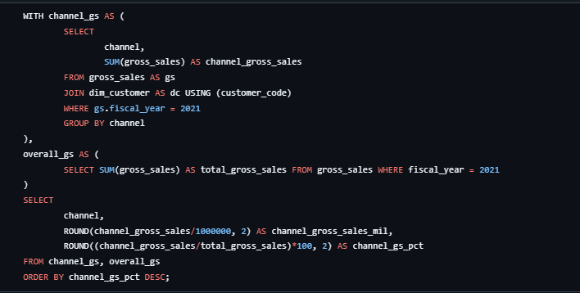
Which channel helped to bring more gross sales in the fiscal year 2021 and the percentage of contribution?
Overall, 73.23 % of AtliQ’s majority Gross Sales were conducted through their Retailer channel.
In contrast, sales through Direct channel (15.47 %) and Distributor channels (11.30 %) together make up around a quarter of the total revenue

Slide 15

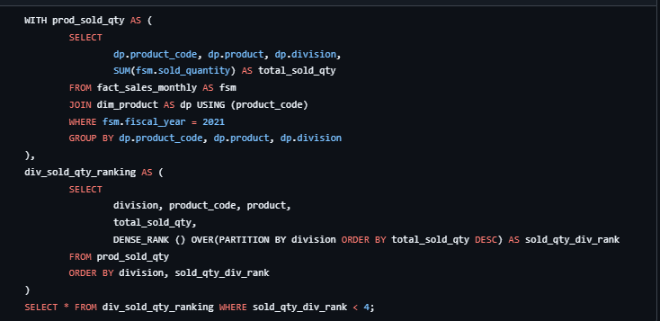
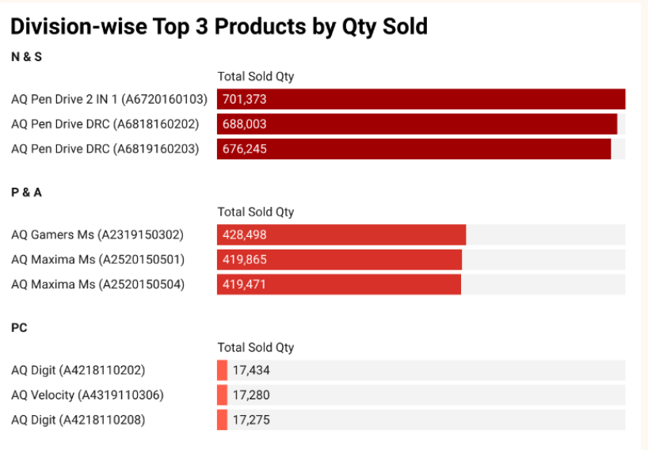
Get the Top 3 products in each division that have a high total sold quantity in the fiscal year 2021?
Top 3 best-selling products in the N & S division were Pen drives.
-Top 3 best-selling products in the P & A division were Mouse.
-Top 3 best-selling products in the PC division were

Slide 16
THANK YOU
Thanks for checking out this project , this project was part of the Codebasics Data Analyst 4.0 Bootcamp

